Slide 1
Disaster Preparedness & Planning Management
UNIT – V
Disasters, Environment and Development - Factors affecting vulnerability such as impact of developmental projects and environmental modifications
(including of dams, land use changes, urbanization etc.),
Sustainable and environmental friendly recovery;
Reconstruction and development methods

Slide 2
Factors affecting vulnerability such as impact of developmental projects and environmental modifications
Factors affecting vulnerability
Poverty
Livelihoods
Cultural beliefs
Equity
Gender
Weaker social groups

Slide 3
Poverty:
Widening gap - Rich and Poor.
Small landowners - decrease the returns from cultivating the land, thus reducing food security.
Newcomers to an urban setting - extremely vulnerable to flooding.
Livelihoods:
Principal livelihoods - mainly farming and fishing.
Absence of adequate transport infrastructure.
Hired labourers - finding jobs to meet their basic needs.
Cultural beliefs:
Cultural beliefs and fatalistic attitudes - community’s vulnerability.
Lack of faith in the social system and lack of confidence.

Slide 4
Equity:
Unequal distribution of resources.
Human rights.
Gender:
Men of the family.
Ignoring the wisdom and experience of women.
Denying or limiting - knowledge and capacity development schemes.
Weaker social groups:
Children.
Women.
Elderly and
Disabled people.

Slide 5
Dams
Sub-standard construction materials/techniques.
Spillway design error.
Lowering of dam crest height, which reduces spillway flow.
Geological instability caused by changes to water levels during filling or poor surveying.
Sliding of a mountain into the reservoir (not exactly a dam failure, but caused nearly the entire volume of the reservoir to be displaced and overtop the dam)
Poor maintenance, especially of outlet pipes.
Extreme inflow.
Human, computer or design error.
Internal erosion or piping, especially in earthen dams.
Earthquakes

Slide 6
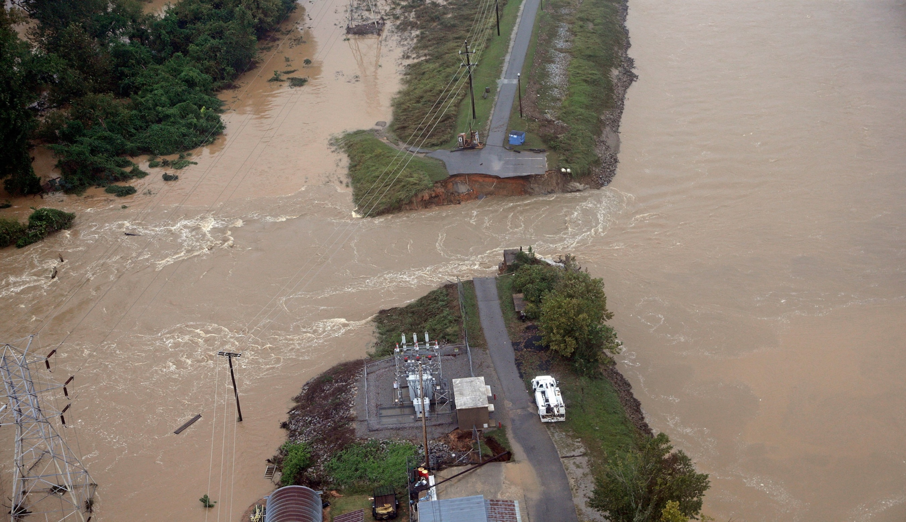

Slide 7
Failures of Dams in India
Machchu-2 Dam - 11-08-1979 – Morbi.
Tiware Dam – 02-07-2019 - Ratnagiri District.
Rishiganga dam – 07-02-2021 - Chamoli, Uttarkhand.

Slide 8
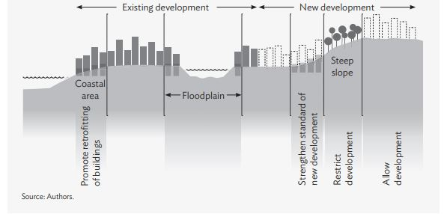
Landuse Changes

Slide 9
For the successful integration of disaster risk considerations into land use planning:
Collaborate with hazard scientists, civil engineers, economists, researchers, emergency management staff and communities at risk.
Use disaster risk information.
Recommend policies that restrict new development in high-risk and environmentally sensitive areas.
Communicate information on disaster risk to all stakeholders.

Slide 10
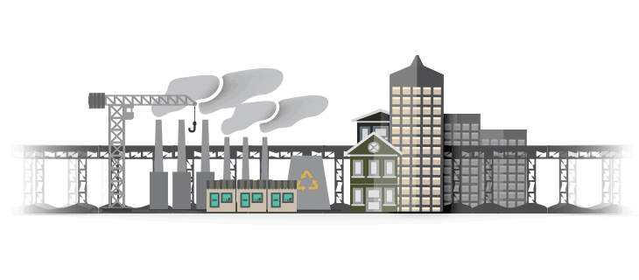
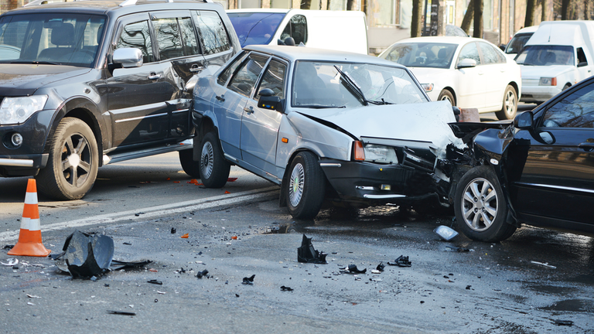
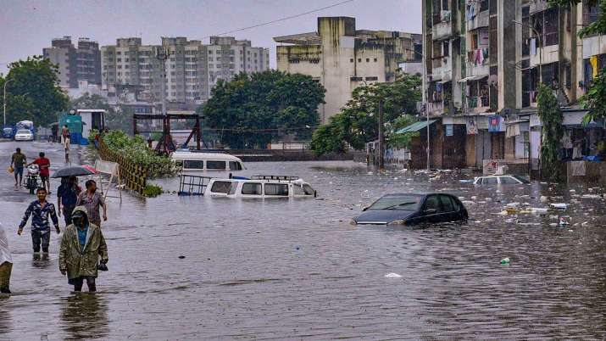
Urbanization

Slide 11
Sustainable and environmental friendly recovery
From disasters to development
The transition from relief to recovery.
Sustainable development.
Increasing individual and institutional capacity.
The transition from relief to recovery.
A distinction is usually made between immediate measures taken to support life and sustain morale, and the later activities dedicated to re-establishing the economic, social and cultural life of the people concerned and rebuilding damaged areas.

Slide 12
Sustainable development
The World Commission on Environment and Development has defined “sustainable development” in terms of livelihood security.
Three key concepts are continually emphasized:
— Organization that is responsive to local needs;
— Improvisation;
— Incremental improvement.
Increasing individual and institutional capacity
Increasing the capacity of people to offset risk, absorb shocks and meet contingencies is central to the goal of sustainable recovery. Reconstruction of a damaged area is not limited to the erection of new buildings.

Slide 13
Assessment for recovery
Continuing relief efforts, such as the provision of emergency shelter, water, sanitation, etc., will not produce recovery alone. By the very nature of the emergency response, such activities are often not well integrated into long-term development processes.
Reconstruction of housing
The number of people concerned, their geographical distribution, age groups, etc.
The number of houses damaged and destroyed and the standard and pattern of housing before the disaster.
The number of families already engaged in repair or rebuilding; the way in which they are organized; the incorporation of risk-reducing features in rebuilding; the assistance they may require and the possibility of encouraging low-cost risk-reducing techniques.

Slide 14
Reconstruction of water-supply and sanitation systems
The number of people affected, their geographical distribution, age groups, etc.
People’s access to protected water supplies and sanitation systems and the pattern of water-related diseases before the disaster.
The data (meteorological, hydrogeological, hydrological, and other relevant data) needed for planning improvements in water supply and sanitation in these areas.
The results of an evaluation of emergency response and urgent repairs and measures (i.e. whether and how emergency measures have actually improved access to protected water and sanitation, and decreased the amount of water- and sanitation- related disease).

Slide 15
Secondary damage assessment
Whereas primary damage assessment involves the rapid appraisal of deaths, injuries and disease, and identification of damage to infrastructure, material resources and services, secondary damage assessment.
Three kinds of loss or disruption.
Loss of livelihood, including.
Loss of social cohesion, owing to.
Loss of cultural identity, owing to.

Slide 16
Secondary vulnerability assessment
The various kinds of losses discussed above under the headings of livelihood, social cohesion and cultural identity can create new vulnerability to future disasters or make existing vulnerability worse.
Recovery planning
A thorough evaluation of the relief response up to the point at which recovery planning begins may reveal that secondary damage to livelihoods, social cohesion, or cultural integrity have been left unaddressed or even unintentionally made worse. In addition, a survey of peoples’ responses to such secondary damage may reveal coping mechanisms that can be reinforced or encouraged during recovery.

Slide 17
Recovery in different contexts
Self sheltering populations
Populations living in longer-term camps
Resettlement
Under many circumstances the worst possible plan is to resettle the people affected by a disaster. First, they are likely to resist such attempts; this has happened repeatedly in a variety of countries. Second, such resettlement programmes are complex and costly.

Slide 18
Rehabilitation and reconstruction for long-term camp residents
Permanent options for residents of a camp are: to become economically independent and integrated with the host population; to return home; or to leave for some other destination.
UNHCR (United Nations High Commissioner for Refugees).

Slide 19
Post-disaster environmental health activities and sustainable development
Vulnerability reduction
To improve their standards of housing, water supply, sanitation, food safety, dietary security and personal hygiene.
People with livelihood security will be less likely to live on a grossly hazardous site.
They will also have time to attend meetings and to become involved in community-based organizations that will represent their interests politically.

Slide 20
Specific implications of sustainable development in environmental health planning
Sustainable development is linked with economic growth.
Sustainable development stabilizes or even improves the ecological basis of livelihoods.

Slide 21
Reconstruction and development methods
Reconstruction is the permanent construction or replacement of severely damaged physical structures.
Improve their standards of housing, water supply, sanitation, food safety, dietary security and personal hygiene.
Development methods
Governmental and
Non-governmental agencies

Slide 22
Rehabilitation and reconstruction for long-term camp residents
Permanent options for residents of a camp are: to become economically independent and integrated with the host population; to return home; or to leave for some other destination.
UNHCR (United Nations High Commissioner for Refugees).

